Slide 1
Brand Positioning II

Slide 2
Overview
Developing a positioning platform
Positioning via perceptual mapping

Slide 3
Developing a Positioning Platform
Identify competitors
Assess consumers’ consideration sets and salient choice criteria: features and benefits
Determine perceived brand positions
Determine consumer ideal points
Select a target positioning and implement
Monitor brand position over time

Slide 4
Perceptual map showing Cadillac’s original position
Has a touch of class/
A car I’d be proud to own
Distinctive looking
IDEAL 2
Porsche
Lincoln
Mercedes
BMW
Cadillac
Spirited
performance
Sporty looking
Fun to drive
Appeals to
young people
Chrysler
Conservative
looking
Appeals to
older people
Buick
Pontiac
Chevrolet
Ford
Nissan
Dodge
Toyota
IDEAL 1
VW
Very practical/ Gives good gas mileage

Slide 5
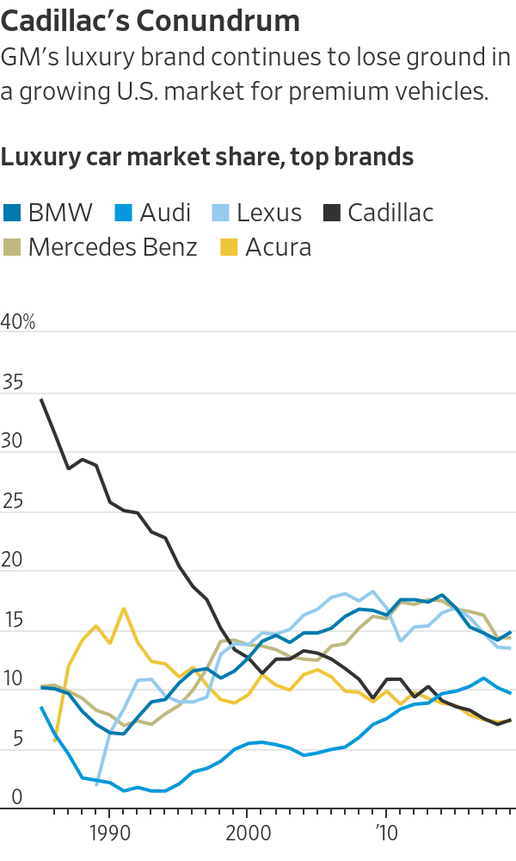
Cadillac’s Conundrum

Slide 6
Perceptual map showing Cadillac’s changing position (dashed arrow)
Has a touch of class/
A car I’d be proud to own
Distinctive looking
IDEAL 2
Porsche
Lincoln
Mercedes
BMW
Cadillac
Spirited
performance
Sporty looking
Fun to drive
Appeals to
young people
Chrysler
Conservative
looking
Appeals to
older people
Buick
Pontiac
Chevrolet
Ford
Nissan
Dodge
Toyota
IDEAL 1
VW
Very practical/ Gives good gas mileage

Slide 7
Measuring Brand Perceptions
Please rate each of the following brands of beer on these dimensions:
    Masculine
    Dark
    Strong
    Filling
Response scale: 1= low; 10= high
    Exclusive
    Thin
    Etc.

Slide 8
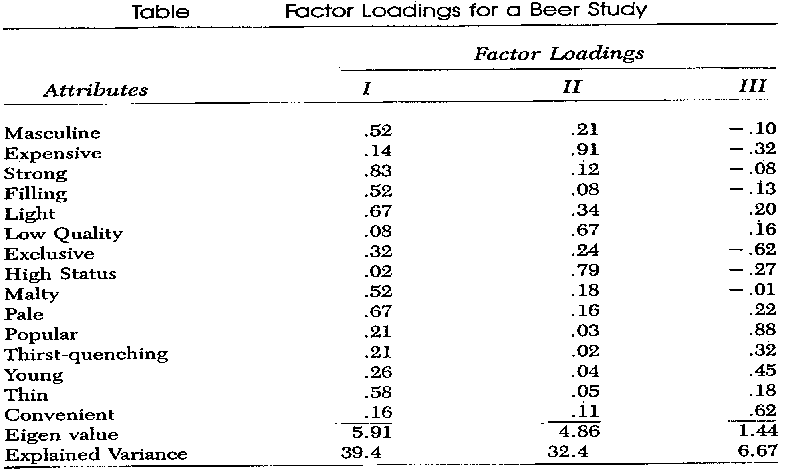
Constructing a Perceptual Map
─
─
─
─

Slide 9
Factor 1* “Dark, Strong Taste”
Masculine .52
Strong .83
Filling .52
Light -.67
Malty .52
Pale -.67
Thin -.58
* = re-organized from previous table

Slide 10
Factor 2* “Expensive”
Expensive .91
Low quality -.67
High status .79
* = re-organized from previous table

Slide 11
Factor 3* “Prestigious”
Exclusive -.62
Popular .88
Young .45
Convenient .62
* = re-organized from previous table

Slide 12
Perceptual Map for Beer
Perceptual Map for Beer
Dark, Strong Taste
(+)
. Guinness
• Samuel Adams
• Budweiser
• Michelob
Pabst •
Expensive/Prestigious
(-)
• Miller
(+)
• Corona
• Coors
• Bud Light
• Amstel Light
• Miller Lite
Coors Lite •
(-)

Slide 13
Conclusion
How does your firm approach the positioning process?
What are the key dimensions of a perceptual map of the market in which you compete?

Slide 14
End of Lecture

